Slide 1
Prelab 5

Slide 2
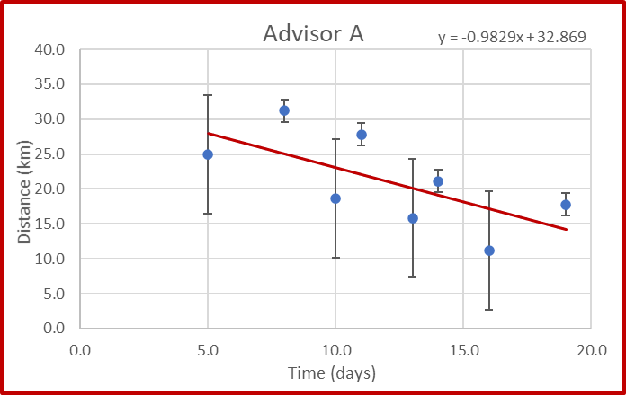
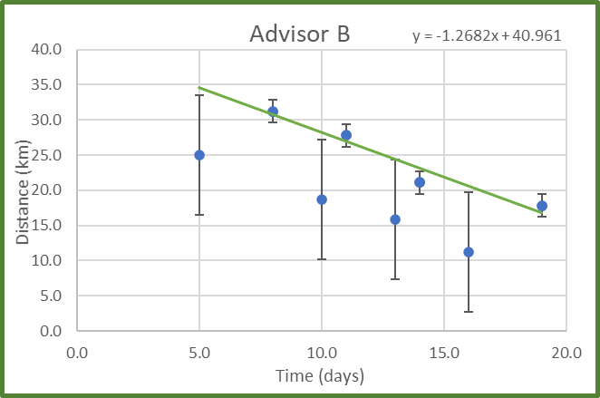
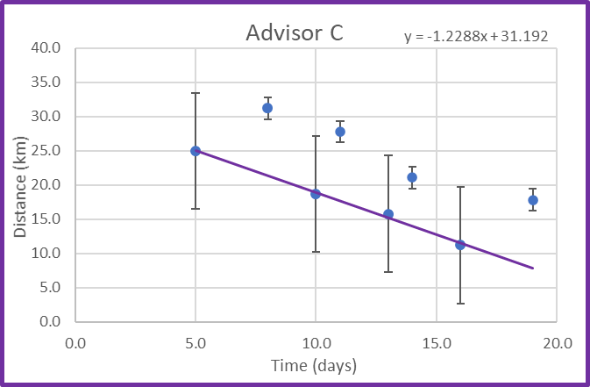
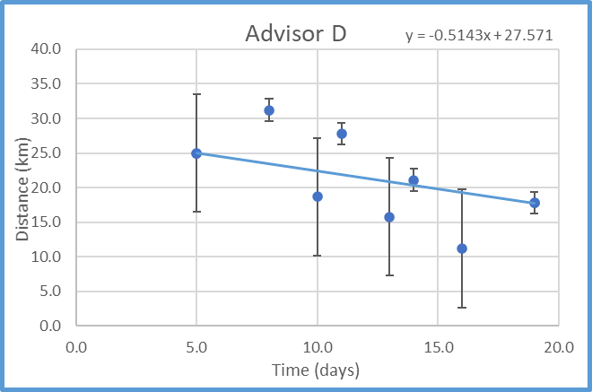
Prelab 5

Slide 3

Prelab 5
Can calculate expected “y” for each data point
$$f\left(x\right)=Ax+B$$

Slide 4

Prelab 5
Can calculate expected “y” for each data point
$$f\left(x\right)=Ax+B$$
Then take the difference between each expected “y” and the actual data point
$$difference=|y_{i}−f\left(x_{i}\right)|$$

Slide 5

Prelab 5
Scale the difference with respect to the uncertainty of each point
$$scaled diff.=\frac{|y_{i}−f\left(x_{i}\right)| }{δy_{i}}$$

Slide 6
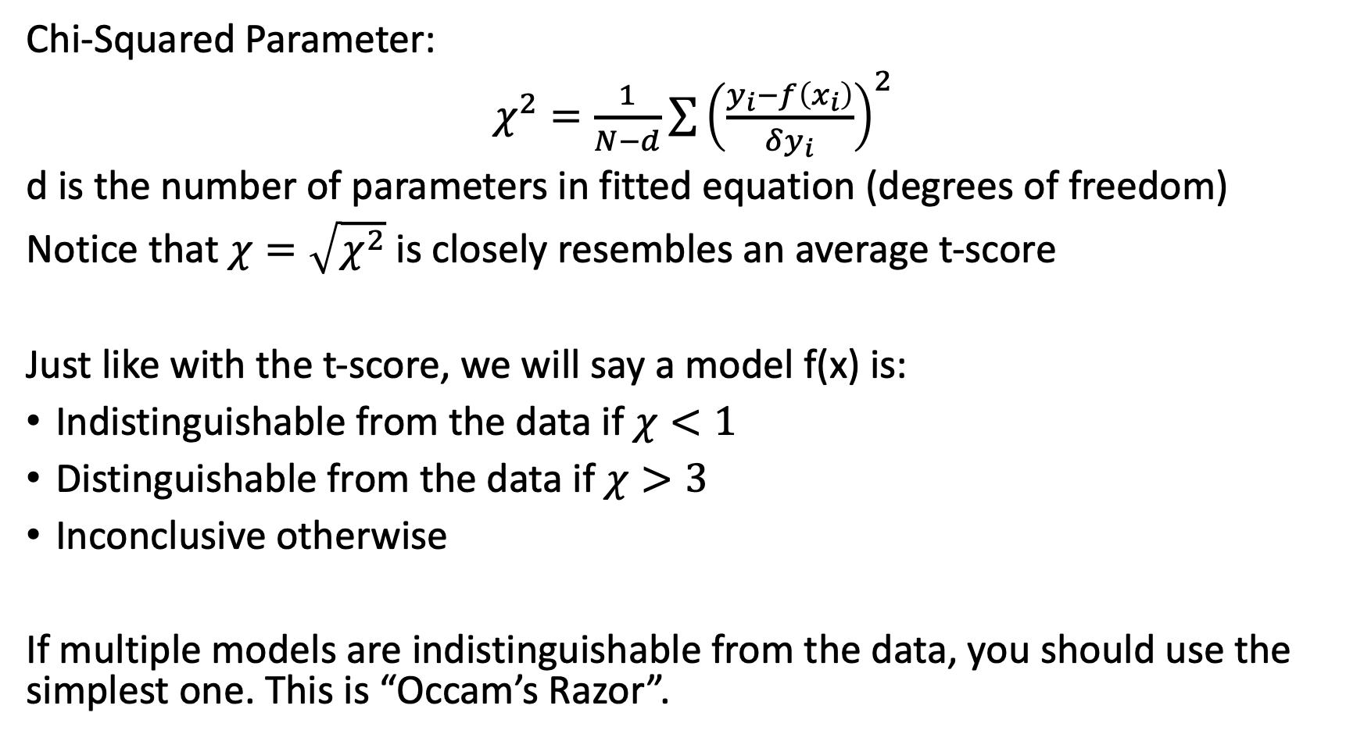
Prelab 5
Chi-Squared Parameter:
$χ^{2}=\frac{1}{N−d}\sum{{\left(\frac{y_{i}−f\left(x_{i}\right)}{δy_{i}}\right)}^{2}}$
d is the number of parameters in fitted equation (degrees of freedom)
Notice that $χ=\sqrt{χ^{2}}$ is closely resembles an average t-score
Just like with the t-score, we will say a model f(x) is:
Indistinguishable from the data if $χ<1$
Distinguishable from the data if $χ>3$
Inconclusive otherwise
If multiple models are indistinguishable from the data, you should use the simplest one. This is “Occam’s Razor”.

Slide 7
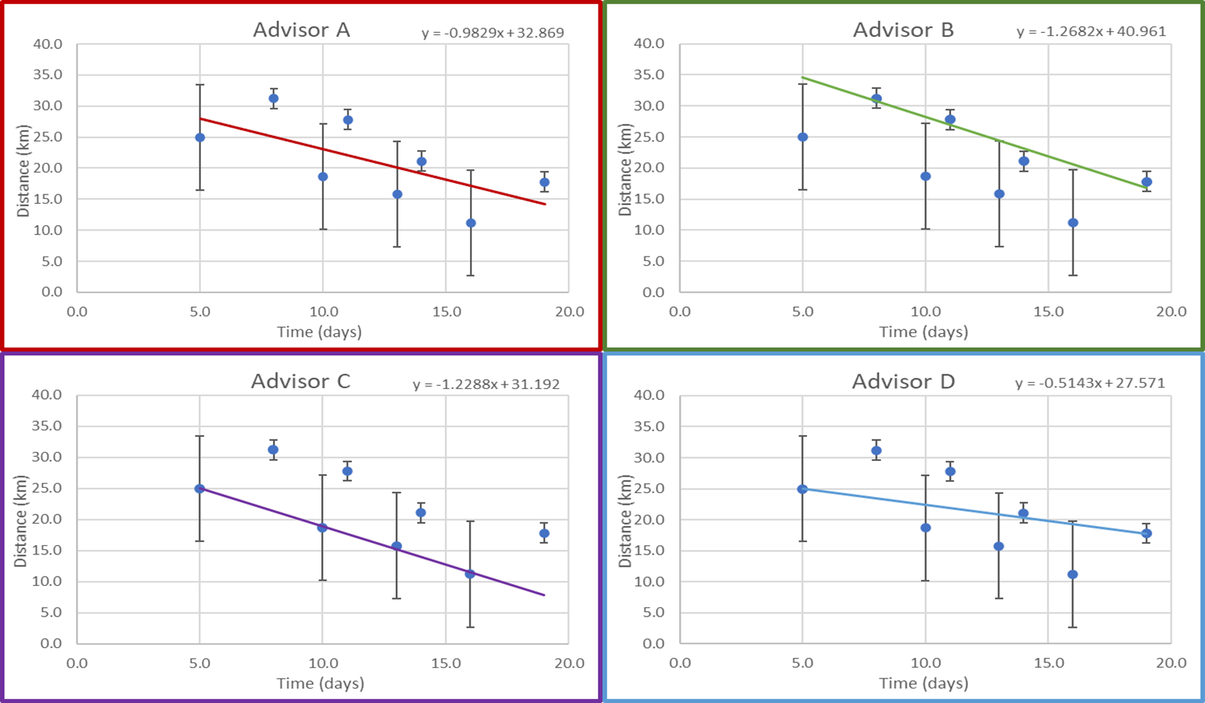
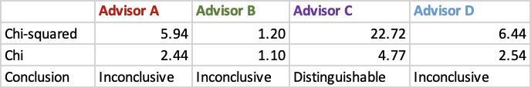
Prelab 5

Slide 8
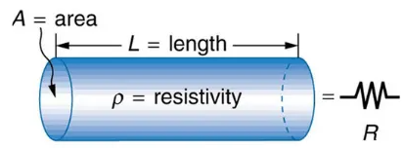
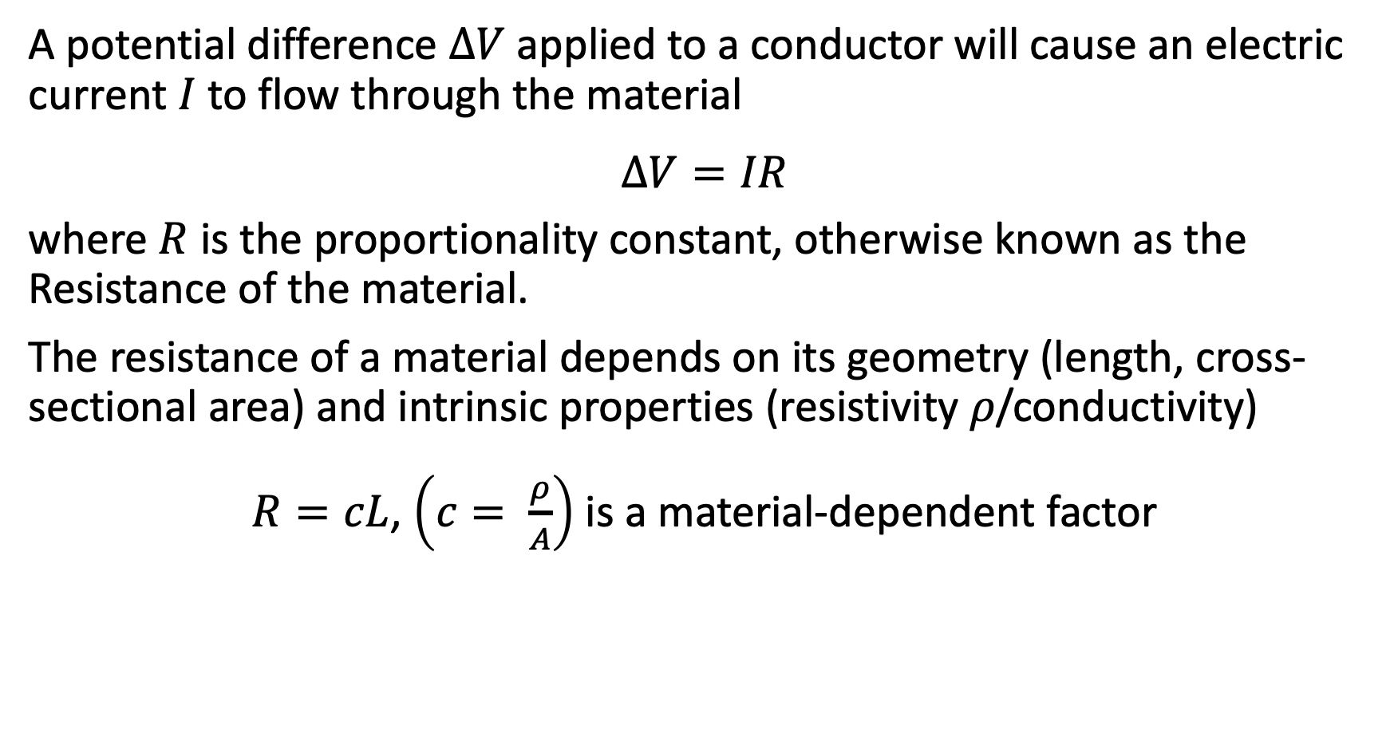
Ohm’s law
A potential difference $ΔV$applied to a conductor will cause an electric current $I$ to flow through the material
$$ΔV=IR$$
where $R$ is the proportionality constant, otherwise known as the Resistance of the material.
The resistance of a material depends on its geometry (length, cross-sectional area) and intrinsic properties (resistivity 𝜌/conductivity)
$R=cL$, $\left(c= \frac{ρ}{A}\right)$ is a material-dependent factor

Slide 9
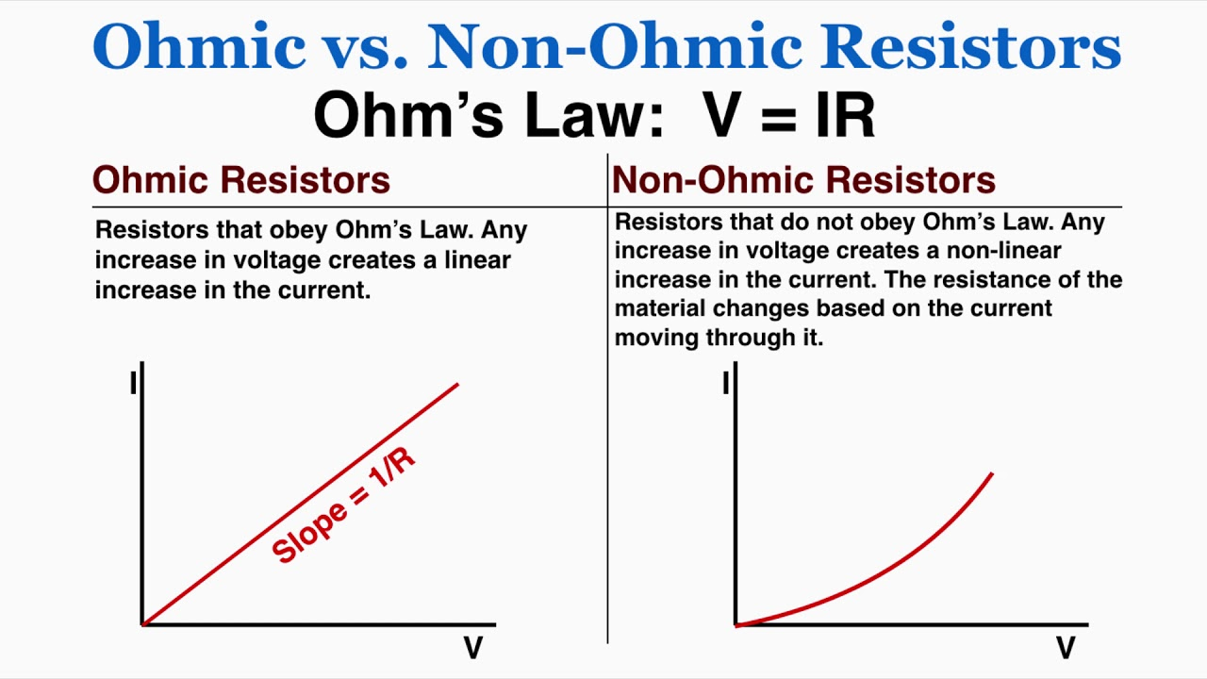

Ohm’s Law
V=IR
V=voltage(V), I=current(A), R=resistance(ohms)
Ohmic object follow ohm’s law V=IR, so if you graph V vs. I graph, it will look linear
For object to be ohmic, the resistance must stay constant. If the object heats up as you pass the voltage then resistance will go up, so V vs. I line will curve up

Slide 10
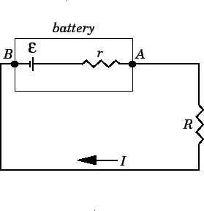
Ideal system
For ideal wire and battery, the resistance should be 0. However, world is not ideal and we will always have small resistance in the wire and battery.
Internal resistance is opposition to the flow of current by the battery resulting in generation of heat
If we have battery in series with resistor and battery has internal resistance, then equation becomes E=IR+Ir
E is the EMF of battery, R is resistance and r is internal resistance

Slide 11
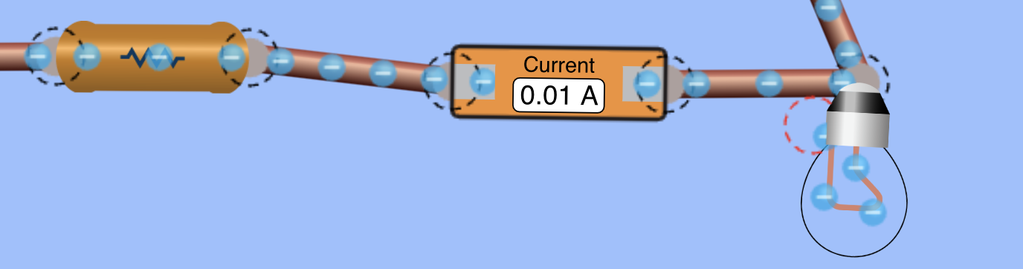
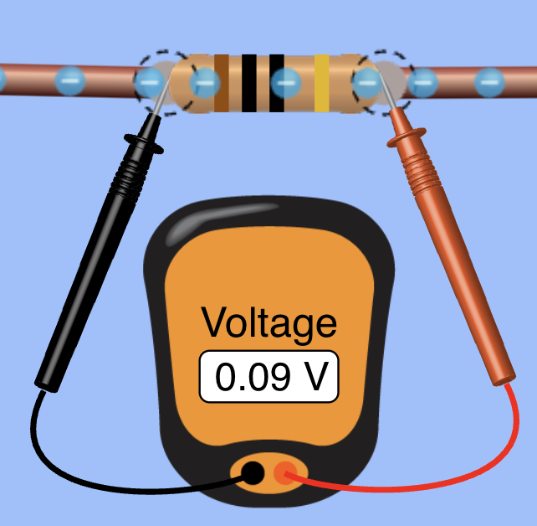
Series and Parallel Measurements
To measure current: connect a multimeter to the circuit in series
To measure voltage or resistance: connect the multimeter in parallel to the element

Slide 12
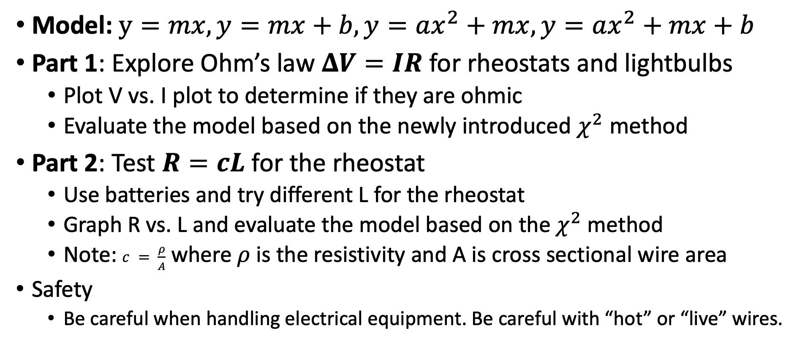
Lab 5
Model: $y=mx, y=mx+b, y=ax^{2}+mx, y=ax^{2}+mx+b$
Part 1: Explore Ohm’s law $ΔV=IR$ for rheostats and lightbulbs
Plot V vs. I plot to determine if they are ohmic
Evaluate the model based on the newly introduced $χ^{2}$ method
Part 2: Test $R=cL$ for the rheostat
Use batteries and try different L for the rheostat
Graph R vs. L and evaluate the model based on the $χ^{2}$ method
Note: $c = \frac{ρ}{A}$ where 𝜌 is the resistivity and A is cross sectional wire area
Safety
Be careful when handling electrical equipment. Be careful with “hot” or “live” wires.

